Slide 1
NET. 012
S.O.L.I.D.
Class 12
Notes:
©2019 John Hinz

Slide 2
Agenda
S.O.L.I.D. – Part 1
Single Responsibility
Open / Closed Principal
Liskov Substitution Principal
Notes:
Section Start Slide

Slide 3
S.O.L.I.D. (an acronym)
Single responsibility principle
a class should have only a single responsibility
Open/closed principle
software entities should be open for extension, but closed for modification.
Liskov substitution principle
objects in a program should be replaceable with instances of their subtypes without altering the correctness of that program.

Slide 4
SOLID (cont.)
Interface segregation principle
many client-specific interfaces are better than one general-purpose interface
Dependency inversion principle
Types (Classes) should depend upon Abstractions. Do not depend upon concretions.

Slide 5
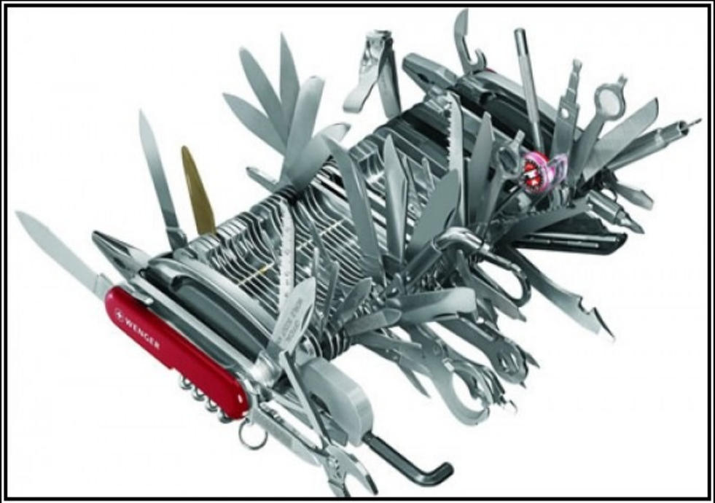
Single Responsibility Principal
The single responsibility principal states that every object should have a single responsibility, and that responsibility should be entirely encapsulated by the class.
There should never be more than one reason for a class to change.
Robert C. “Uncle Bob” Martin

Slide 6
Single Responsibility Principal
Cohesion and Coupling
Cohesion
How strongly-related and focused are the various responsibilities of a module / class
Coupling
The degree to which each program module relies on each of the other modules
Strive for low coupling and high cohesion

Slide 7
Responsibilities are Axes of Change
Requirements changes typically map to responsibilities
More responsibilities == More likelihood of change
Having multiple responsibilities within a class couples together these responsibilities.
The more classes a change affects, the more likely the change will introduce errors.

Slide 8
What is a Responsibility?
A difference in usage scenarios from the user’s perspective
Multiple small interfaces (follow Interface Segregation Principal) can help to achieve the Single Responsibility Principal

Slide 9
Single Responsibility Demonstrated
Before
https://dotnetfiddle.net/lejJqN
After
https://dotnetfiddle.net/1QdgYK
Abstraction
https://dotnetfiddle.net/fIljId

Slide 10
The Open/Closed Principal
The Open / Closed Principle states that:
software entities (classes, modules, functions, etc.) should be open for extension, but closed for modification.
Open to Extension
New behavior can be added in the future
Closed to Modification
Changes to source or binary code are not required

Slide 11
Change behavior without changing code
Rely on abstractions
No limit to the variety of implementations of each abstraction.
In .NET abstractions include:
Interfaces
Abstract classes
Some level of OCP can be achieved via parameters (Inversion of control)

Slide 12
Approaches to Achieve the Open /Closed Principal
Parameters (Procedural Programming)
Allow client to control behavior specifics via a parameter
Combined with delegates/lambda, can be very powerful approach
Inheritance / Template Method Pattern
Child types override behavior of a base class (or interface)

Slide 13
When to apply the Open/Closed Principal
Experience Tells You
If you know from your own experience in the problem domain that a particular class of change is likely to recur, you can apply OCP up front in your design
Fool me once, shame on you; fool me twice, shame on me
Don’t apply OCP at first
If the module changes once, accept it.
If it changes a second time, refactor to achieve OCP

Slide 14
Open/Closed Principal Demonstrated
Before
https://dotnetfiddle.net/y68knC
Before with addition
https://dotnetfiddle.net/Is248z
After
https://dotnetfiddle.net/zxhV4x

Slide 15
The Liskov Substitution Principle
The Liskov Substitution Principle states that:
Subtypes (child class) must be substitutable for their base (parent class) types.
Named for Barbara Liskov, who first described the principle in 1988.

Slide 16
Substitutability
Child classes must not:
Remove base class behaviour.
Violate base class invariants.
Derived classes are extending the base classes without changing their behavior
Require calling code to know they are different form their base type.

Slide 17
Invariants
Consist of reasonable assumptions of behavior by clients
Can be expressed as preconditions and post conditions for methods
Frequently, unit tests are used to specify expected behavior of a method or class
To follow LSP, derived classes must not violate any constraints defined (or assumed by clients) on the base classes

Slide 18
Liskov Substitution Principal Demonstrated
Before
https://dotnetfiddle.net/AQkzN4
After
https://dotnetfiddle.net/1f7Nmj

Slide 19
Additional Information / Reading
Single Responsibility Principal
http://www.objectmentor.com/resources/articles/srp.pdf
Dr. Bertrand Meyer originated the OCP term in his 1988 book, Object Oriented Software Construction
Agile Principles, Patterns, and Practices by Robert C. Martin and Micah Martin [http://amzn.to/agilepppcsharp]

Slide 20
THANK YOU.
Notes:
Sign Off Slide

